Slide 1

East Bay Stand Down 2018
Jerry Yahiro, Executive Board Chairman

Slide 2
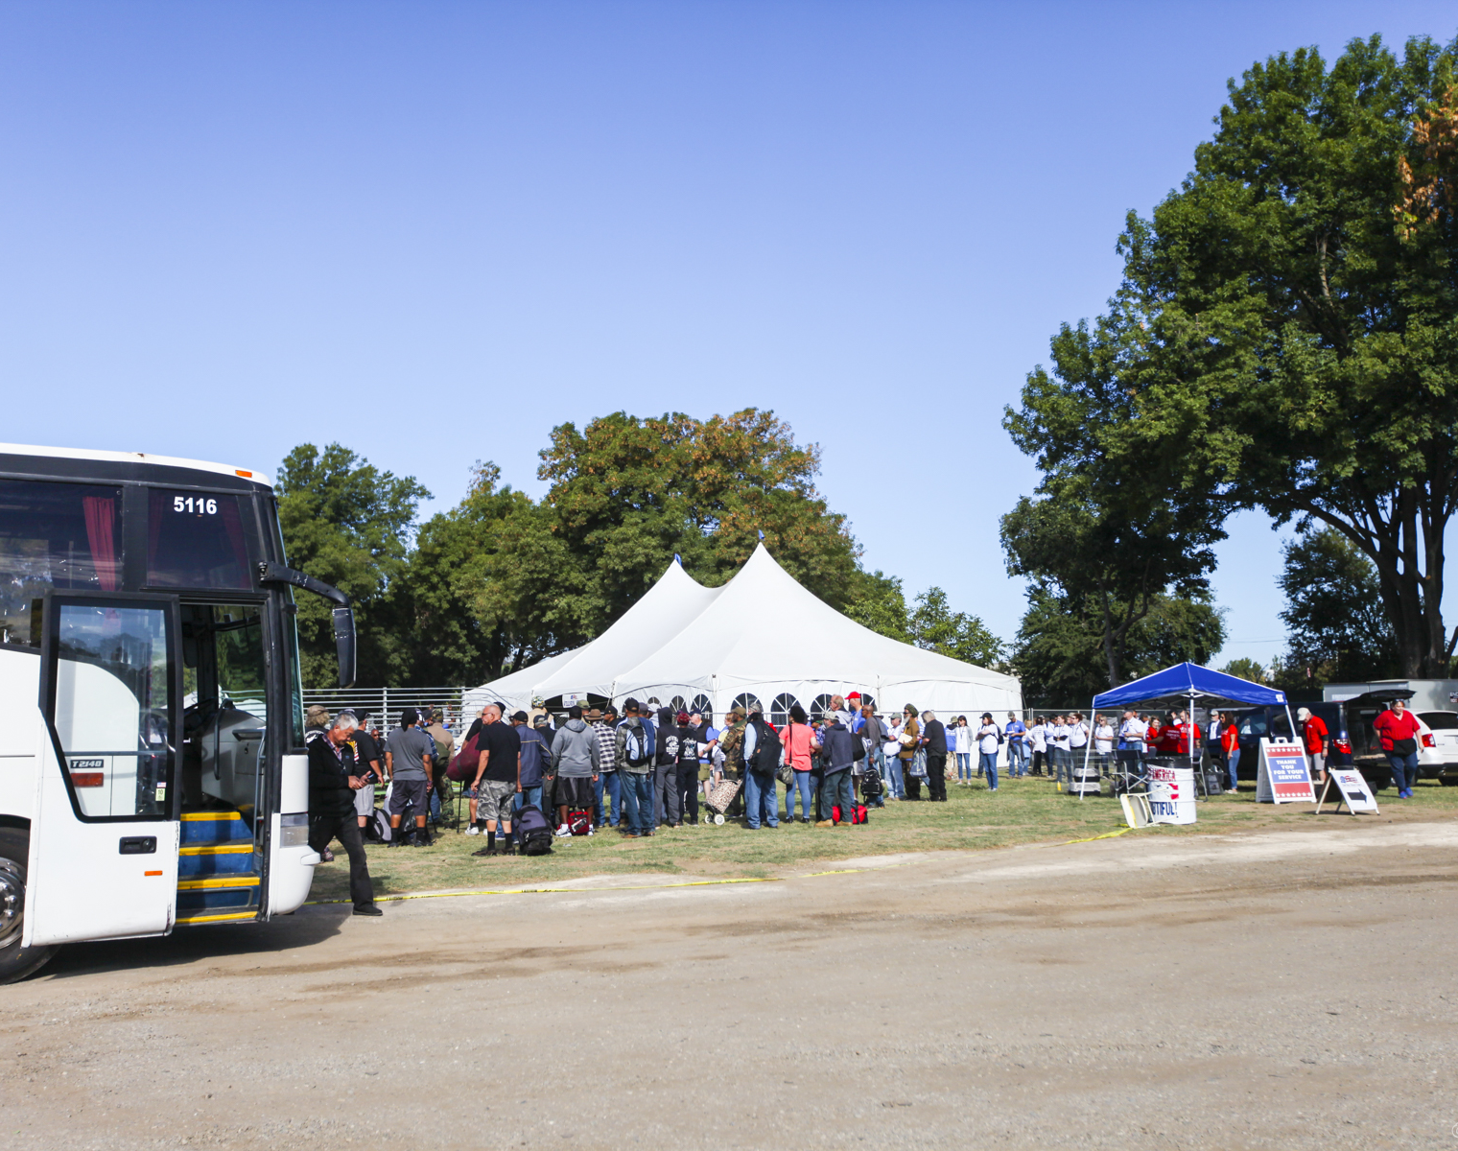
Entry of the Veterans
278 participants were bused in, then registered
233 Male Veterans
24 Female Veterans
21 Family members
The oldest was in his 80’s and the youngest were in their 20’s

Slide 3
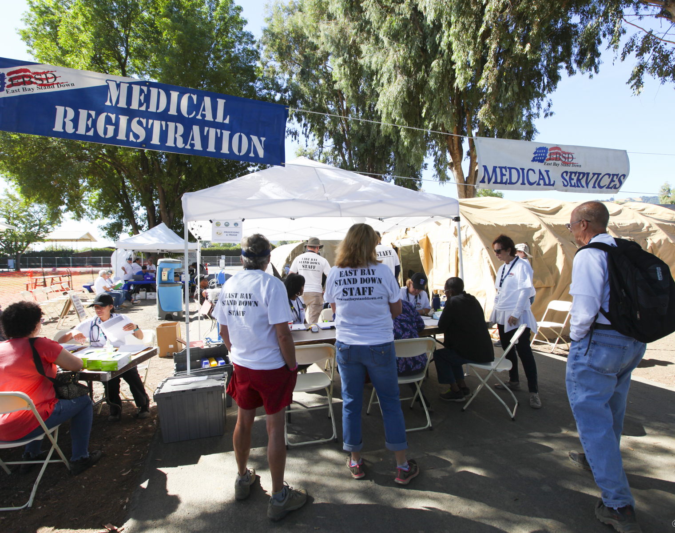
Medical Services
Medical and Dental services are available
156 Veterans had Dental services completed

Slide 4
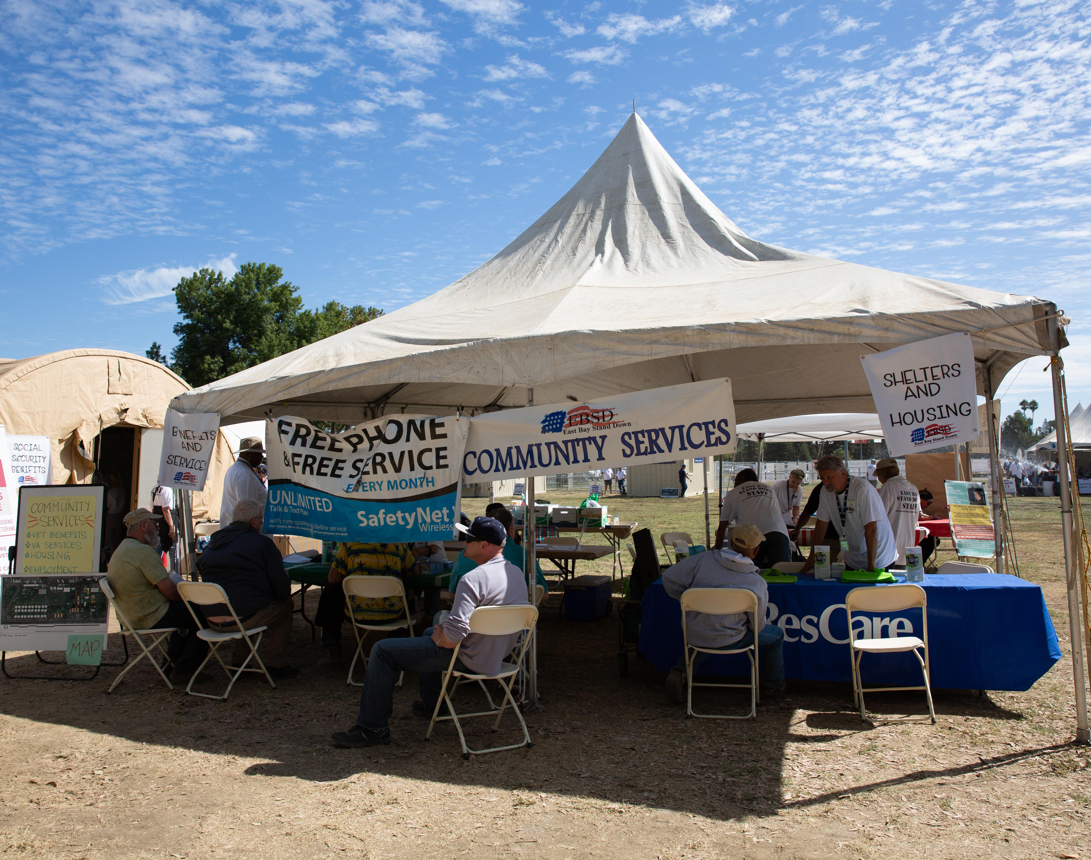
Community Service
Community services/providers included:
Housing
Jobs
Phones

Slide 5
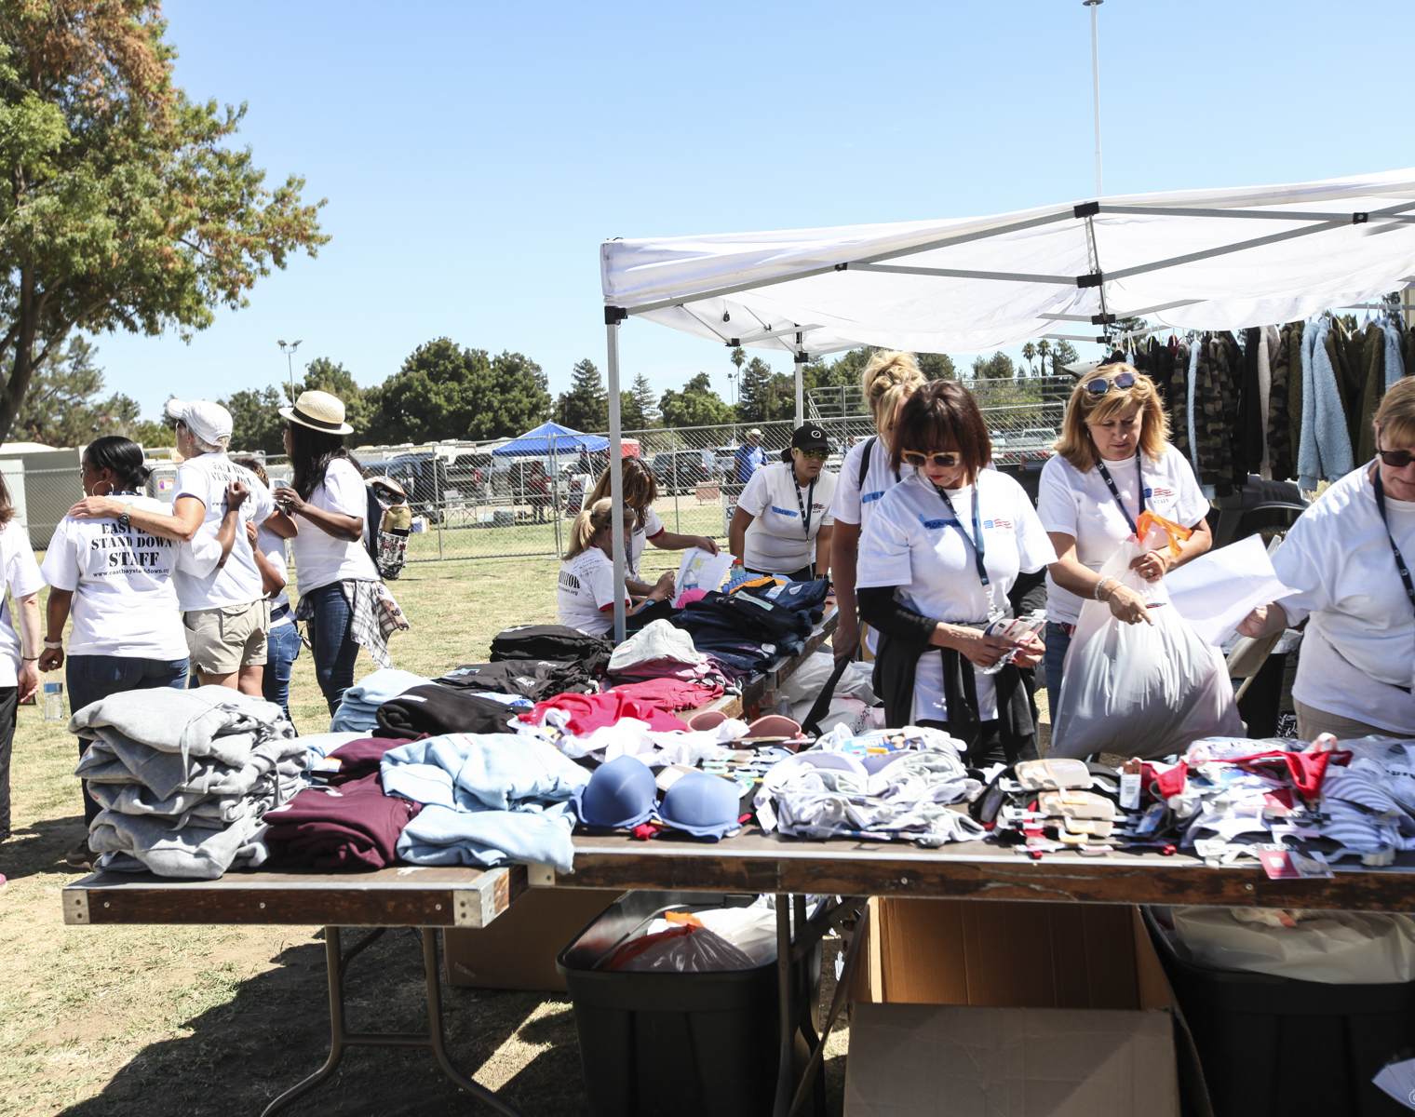
Clothing
Clothing and shoes were provided:
Jeans – 230
T-shirts – 690
Underwear – 690
Sweatshirts – 300
Boots – 200
Socks – 1000+

Slide 6
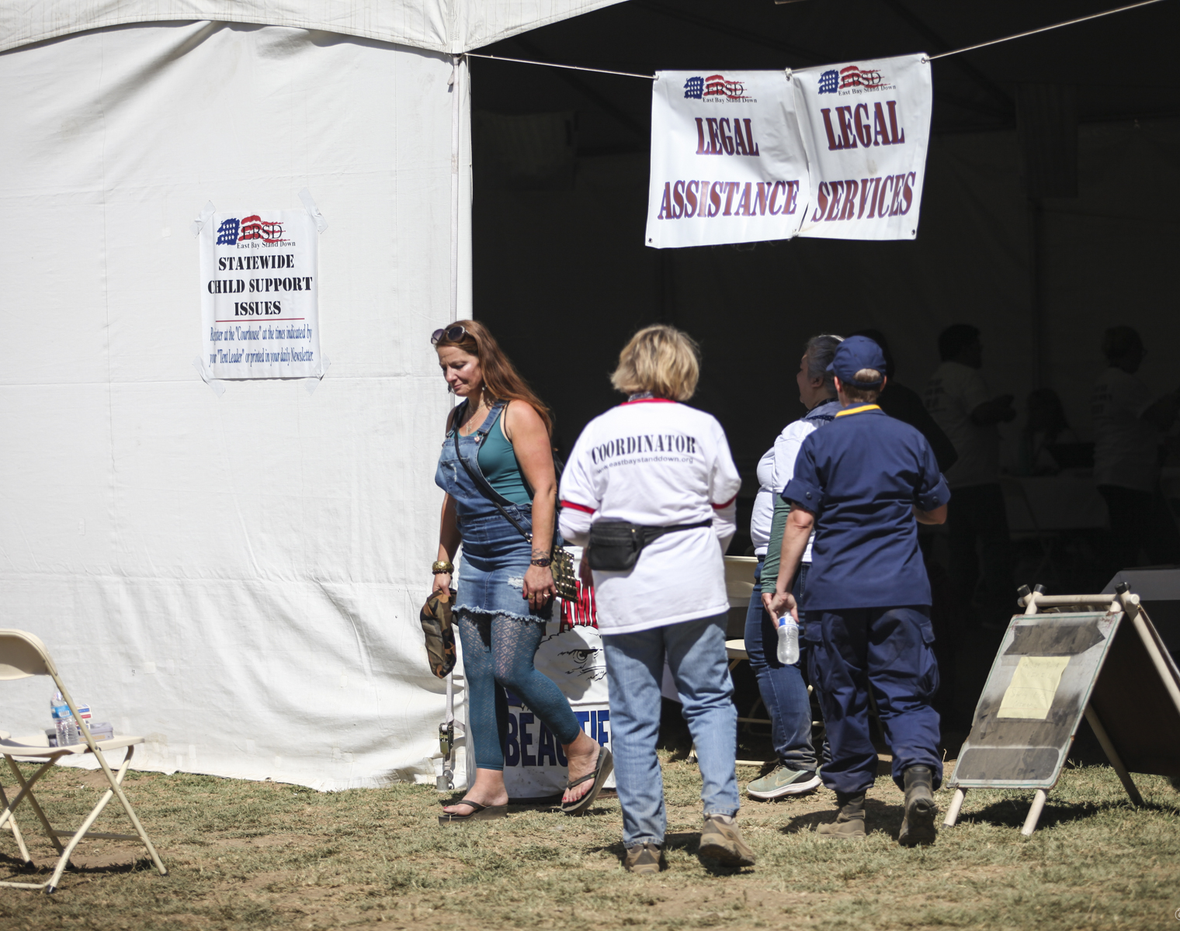
Legal Services and Court
Legal services are available and on Saturday morning a multi-county Court adjudicated non-felony offenses

Slide 7
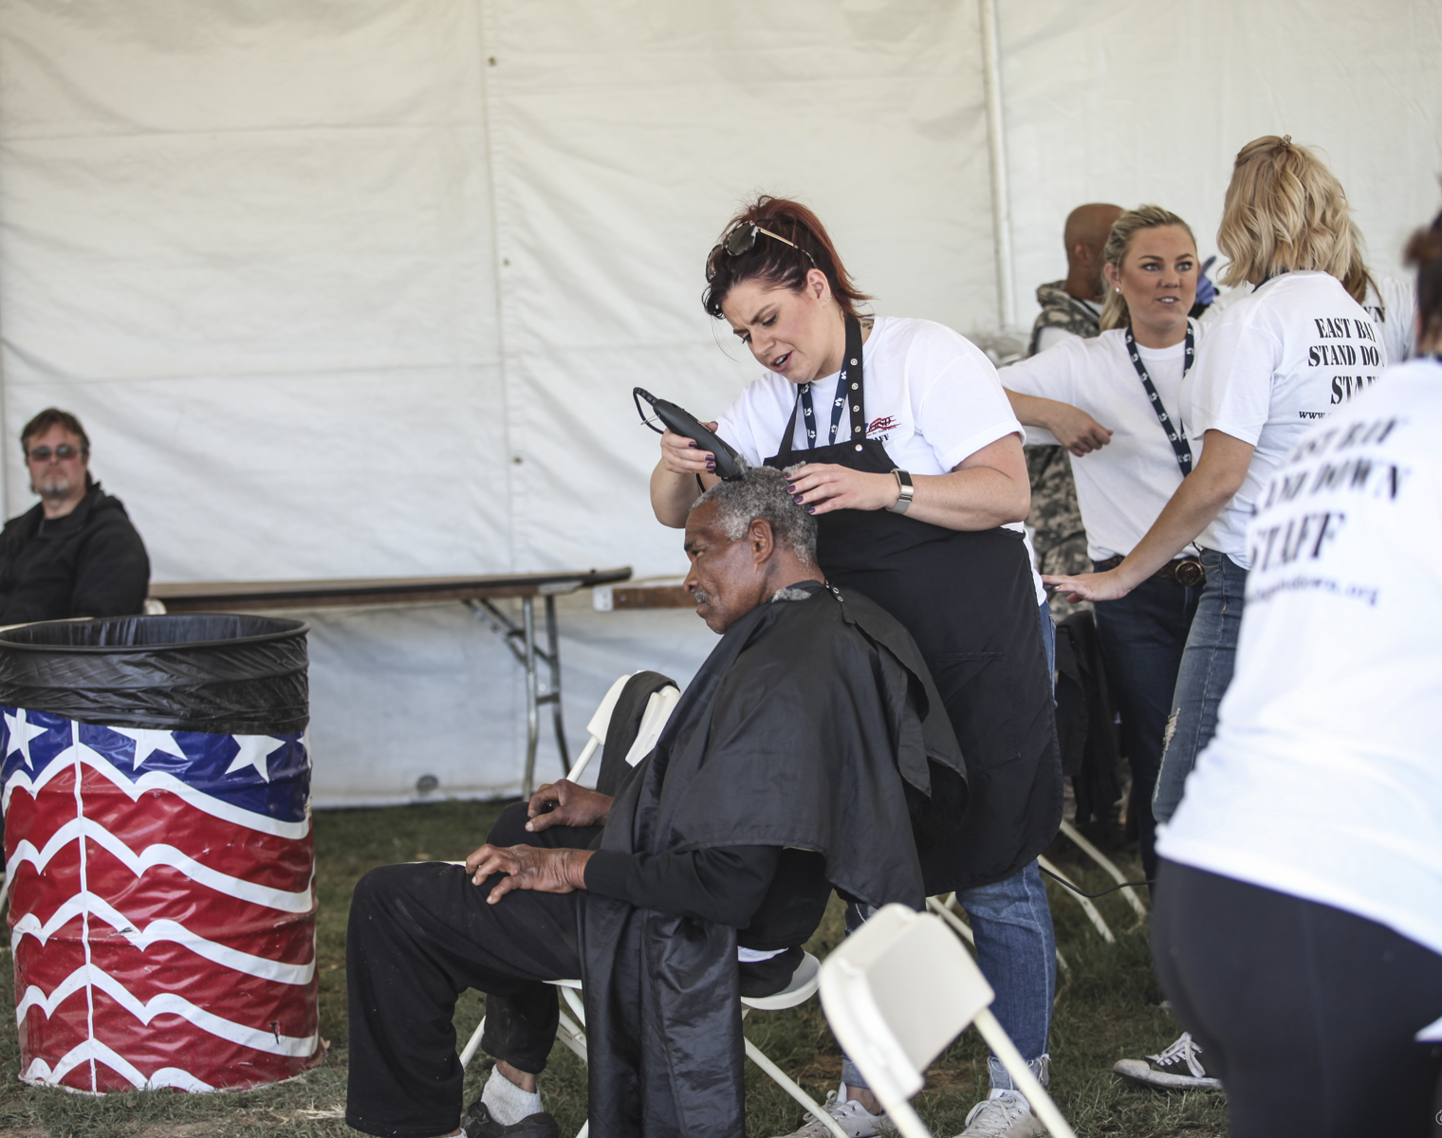
Hygiene
Showers – 462+
Haircuts - 249
Laundry service provided

Slide 8
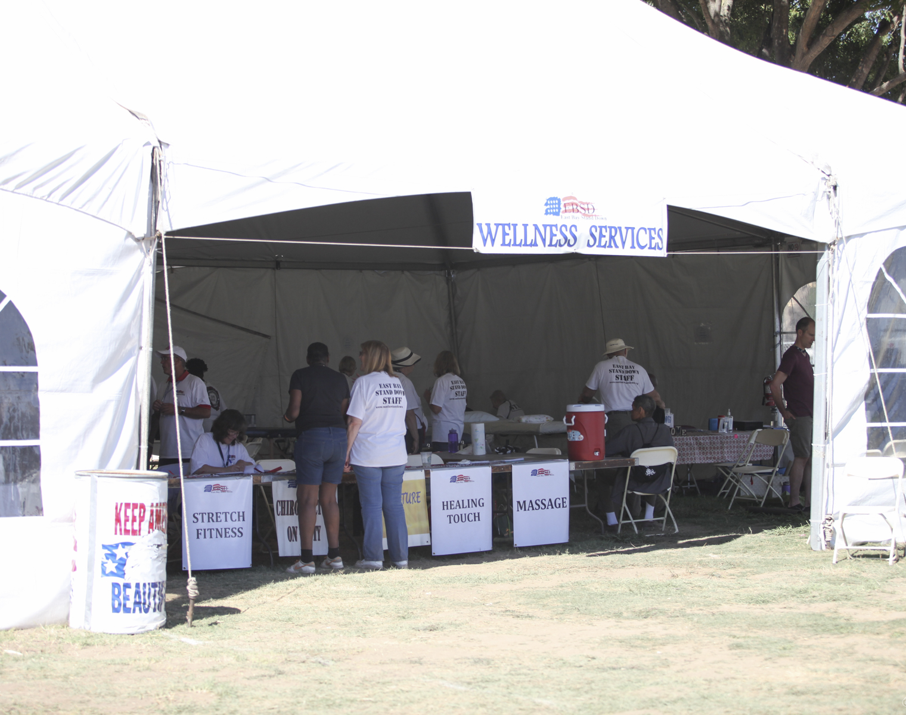
Wellness Services
Chiropractors
Massage Therapists
Acupuncturists
Yoga
Stretch Fitness
Equine Therapy

Slide 9
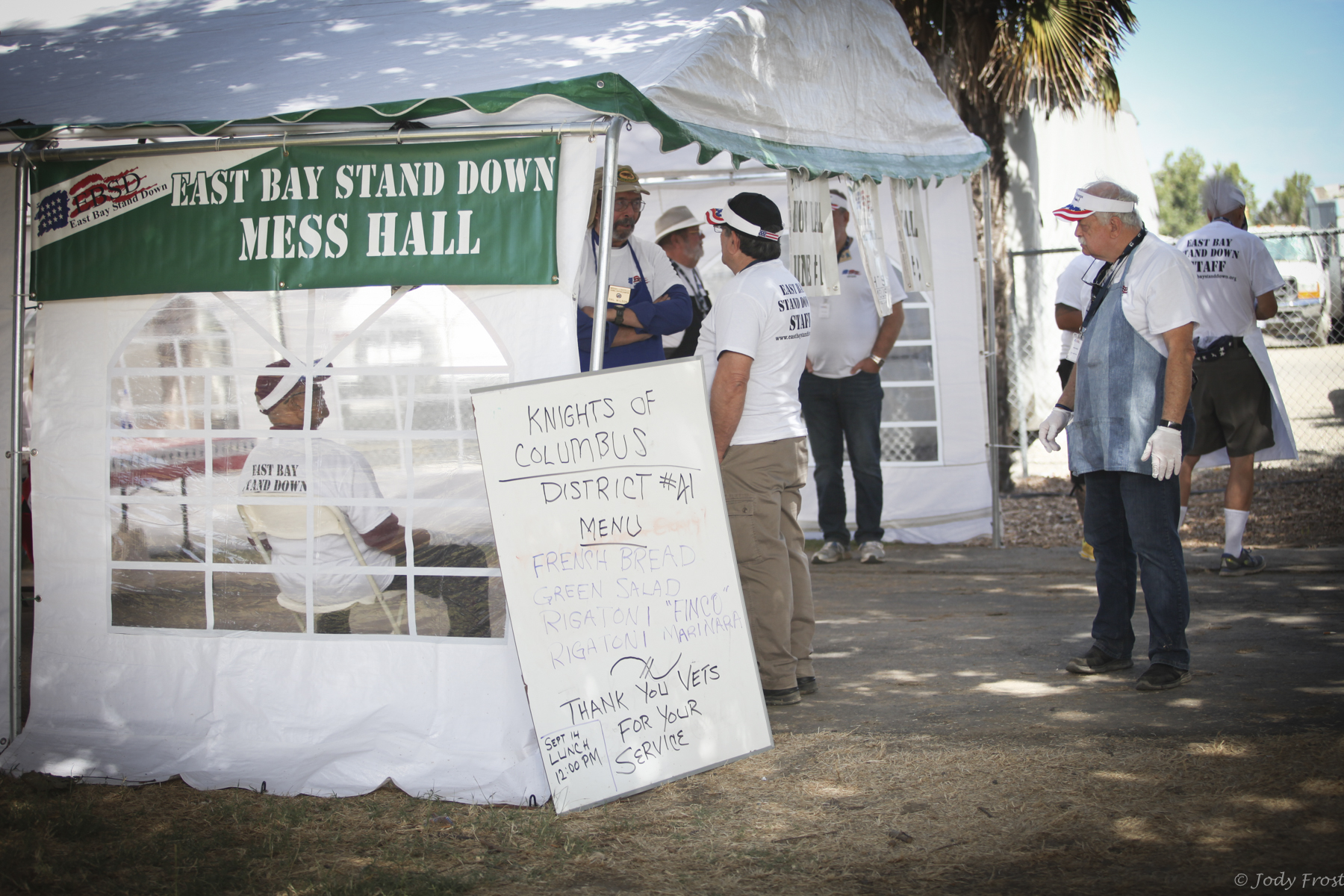
Mess Hall
Meals served:
Thursday 9/13 – 743 meals
Friday 9/14 – 1465 meals
Saturday 9/15 – 1444 meals
Sunday 9/16 – 788 meals (not counting take-away bags on Sunday)

Slide 10
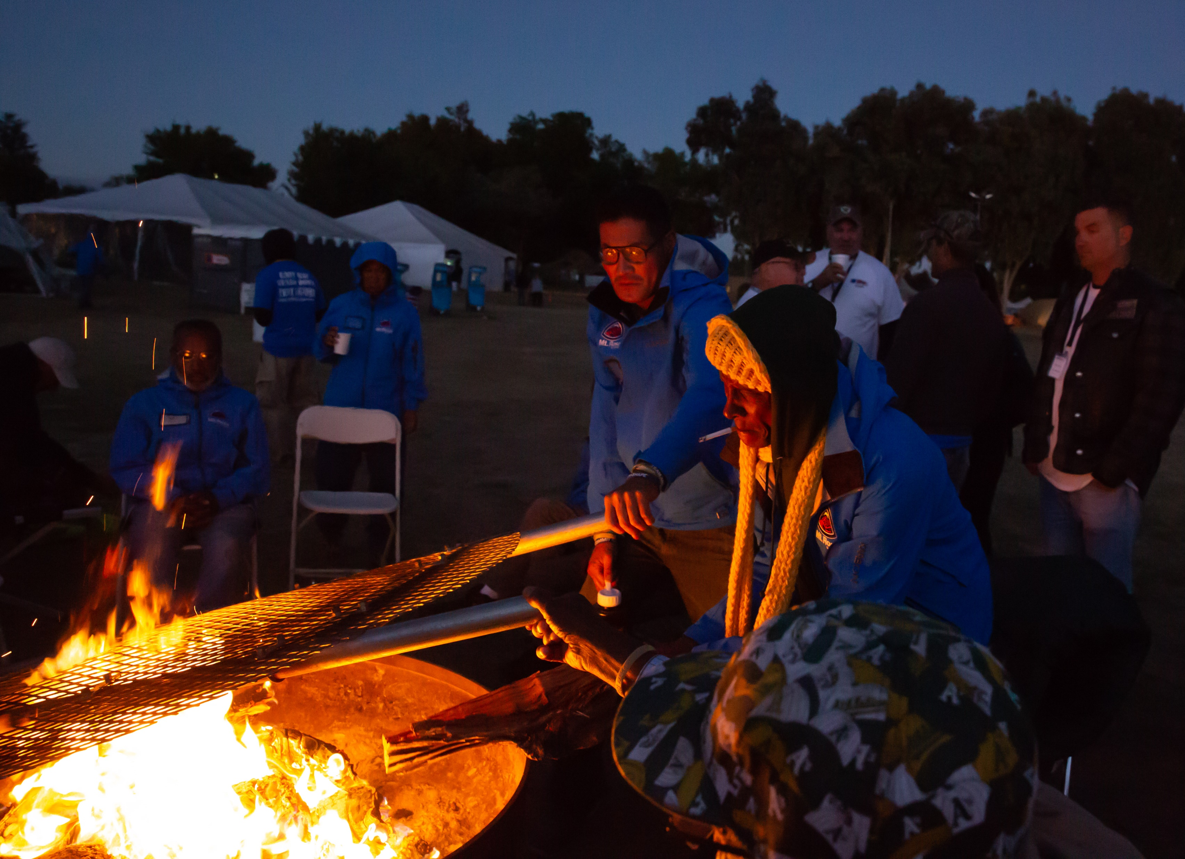
Recreation
Musical Performers
Evening campfires
Cards
Dominos
Books

Slide 11
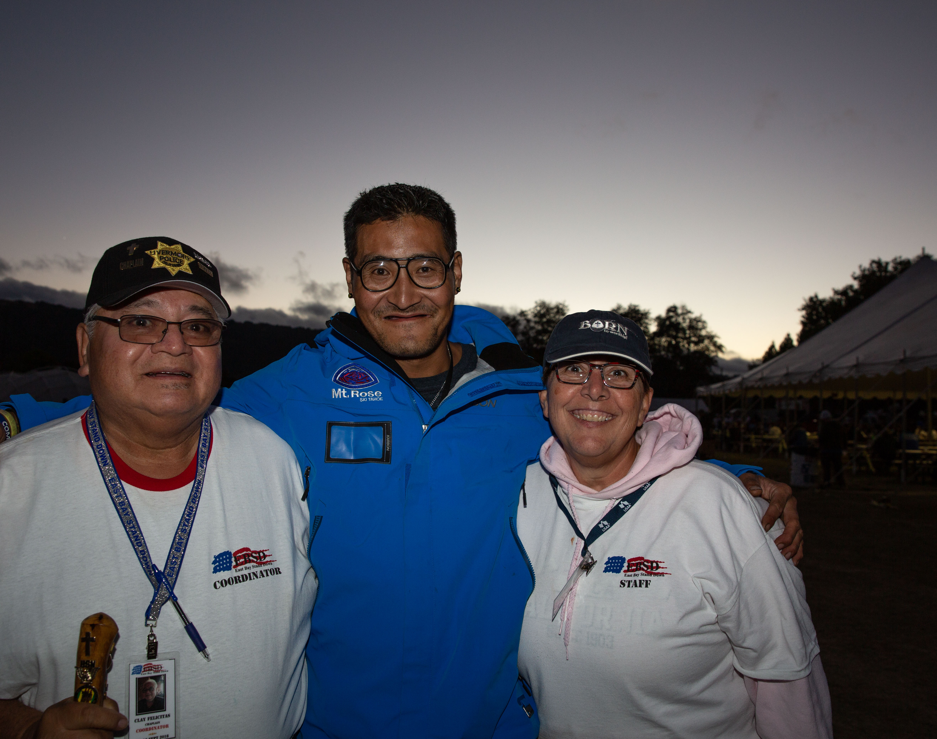
Chaplains
121 One-on-one visits

Slide 12
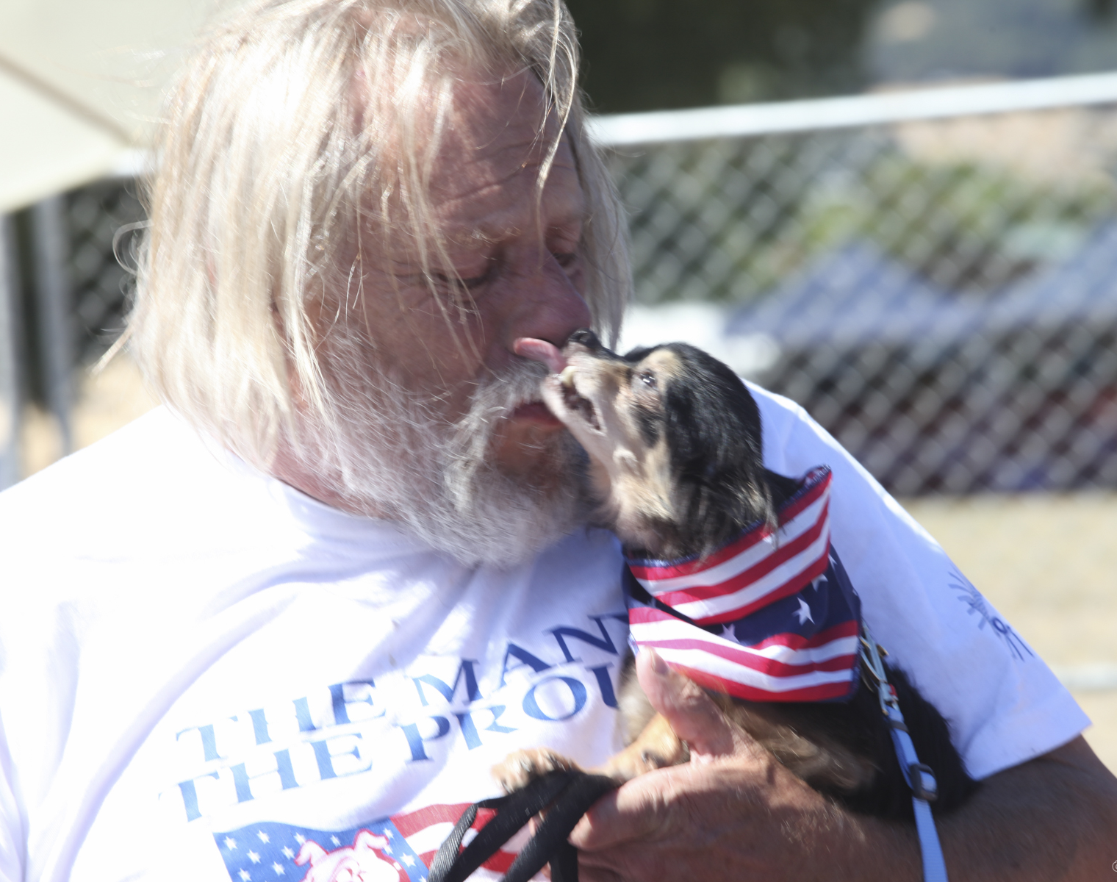
Animal Care
30 Dogs and 5 cats were cared for by TVAR while their Veterans received services

